Slide 1
WORKING CAPITAL MANAGEMENT

Slide 2
What Is Working Capital Management?
Working capital management is a business strategy designed to ensure that a company operates efficiently by monitoring and using its current assets and liabilities to the best effect. The primary purpose of working capital management is to enable the company to maintain sufficient cash flow to meet its short-term operating costs and short-term debt obligations.
A company's working capital is made up of its current assets minus its current liabilities.

Slide 3
OBJECTIVES OF WORKING CAPITAL MANAGEMENT
The primary objectives of working capital management include the following:
Smooth Operating Cycle: The key objective of working capital management is to ensure a smooth operating cycle. It means the cycle should never stop for the lack of liquidity whether it is for buying raw material, salaries, tax payments etc.
Lowest Working Capital: For achieving the smooth operating cycle, it is also important to keep the requirement of working capital at the lowest. This may be achieved by favorable credit terms with accounts payable and receivables both, faster production cycle, effective inventory management etc.

Slide 4
Cost of Capital: It is important to understand that the interest cost of capital is one of the major costs in any firm. The management of the firm should negotiate well with the financial institutions, select the right mode of finance, maintain optimal capital structure etc.
Optimal Return on Current Asset Investment: In many businesses, you have a liquidity crunch at one point of time and excess liquidity at another. This happens mostly with seasonal industries. At the time of excess liquidity, the management should have good short-term investment avenues to take benefit of the idle funds..

Slide 5
IMPORTANCE OF EFFECTIVE WORKING CAPITAL MANAGEMENT
Although the importance of working capital is unquestionable in any type of business. Working capital management is a day to day activity, unlike capital budgeting decisions. Most importantly, inefficiencies at any levels of management have an impact on the working capital and its management. Following are the main points that signify why it is important to take the management of working capital seriously.
Ensures Higher Return on Capital
Improvement in Credit Profile
Increased Profitability
Better Liquidity
Business Value Appreciation
Most Suitable Financing Terms
Interruption Free Production
Readiness for Shocks and Peak Demand
Advantage over Competitors

Slide 6
It is useful for the following purposes:
(a) It is the total investment in current assets which earns profit.
(b) Management can give attention to manage very efficiently and carefully each item of the current assets in order to minimize bad debt, slow-moving and non-moving items, idle cash etc.
(c) It takes into consideration of the fact that, if other things remain constant, infusion of fund in the business increases its working capital.
(d) It enables management to compute the rate of return on total investment in current assets.

Slide 7
Determinants capital of needs
The availability of working capital is probably the most critical aspect of running a business smoothly and successfully. Also known as the current capital, working capital basically refers to the cash available with an organization for managing its daily operations and is calculated by simply deducting the current liabilities of a business from its current assets.
Assets that can be easily converted into cash within a year or a business cycle are termed as current assets and include cash, accounts receivables, inventories and short-term prepaid expenses. Similarly, current liabilities are the ones that a business needs to pay off within a year or one business cycle and includes accounts payable, accrued liabilities, accrued income taxes and dividends payable.

Slide 8
If current assets are greater than current liabilities, the business has a positive working capital situation or extra cash to meet unexpected expenses. Conversely, if the current liabilities are more than the current assets, the business is said to have negative working capital and needs to take working capital business loans.
Adequate cash availability also allows a business to take care of newer opportunities that require quick infusion of funds. However, not all businesses have access to adequate funds to carry out their operations smoothly and often need working capital loans.

Slide 9
Working Capital: Need and Importance
Every business needs to maintain some working capital to continue its operations smoothly. The amount of liquid funds available with a business is a measure of its ability to meet its short-term obligations. It is also a reflection of a company’s operational efficiency. Here are some reasons why working capital is essential:
Smooth Running of Business: Funds are needed for the smooth working of day-to-day operations and spending on the purchase of raw materials, overhead expenses and payment of wages and salaries. Working capital enables an uninterrupted flow of production or provision of services.
Goodwill: Sufficient cash with a business means it is capable of making prompt and timely payments, which in turn enhances its goodwill.

Slide 10
Easy Loans: Banks and financial institutions prefer to lend to organizations with adequate working capital.
Ability to Deal with Unexpected Expenses: Adequate availability of funds prepares a business to meet any unexpected expenses or situations. Working capital is often used to judge the financial health of a business. A positive working capital situation indicates that a business is capable of paying off all its short-term debts, operating expenses and salaries with some extra amount remaining for reinvestment. In contrast, negative working capital is a cause for concern. It hints that the business may not be able to pay off its creditors.

Slide 11
Need for Working Capital Finance
Many businesses do not have sufficient cash in hand or liquid assets like money in the current account to meet their daily operational expenses. This is where working capital finance comes to their rescue. Small retailers or merchants typically require capital to fund seasonal inventory buildup. Also, businesses that do not have stable revenues through the year may still need to maintain a specific amount of inventory to fulfill any sudden increase in demand for their products. Such units often require a working capital loan to pay wages or meet other expenses during lean periods or when they are servicing an order, and the receivables would become due only after order fulfilment.

Slide 12
A working capital business loan is a short-term finance option that is generally repaid in the period when sales are high and the company has surplus cash. A major benefit of such credit is that its terms is short, which allows a business to maintain full control of its operations. Such loans need to be sanctioned quickly, without a lengthy approval process. Working capital funding can be secured or unsecured, depending on the financial product or lender.

Slide 13
Determining Your Working Capital Needs
The proper assessment of working capital needs is an important part of efficient financial planning. It allows a business to plan well and arrange the necessary funds on time to ensure smooth functioning of daily operations. The amount of current or working capital required by a business may vary. It is dependent on the operating cycle, or the amount needed to pay suppliers, the amount of inventory held and the time taken to collect cash from customers. Also, this may change with changes in demand for its products and services.

Slide 14
The working capital requirements of a business can be calculated by subtracting the accounts payable from the sum of the inventories and accounts receivables. Businesses need to fill the working capital gap by using internally generated profits or external borrowings or a combination of the two.
In case of new units or startups, working capital refers to the amount of money to be borrowed to keep operations going until the business starts generating adequate revenues to cover its operational expenses. Calculating the amount required to carry on business in the initial few months when there are no or very little revenues challenging and often leads to businesses borrowing too much or too little. A business should look towards raising working capital loans that have a prepayment option, or the option to repay the loan before the term is over.

Slide 15
Raising Working Capital Business Loans
Financial institutions use two ratios – the current ratio and the quick ratio – to measure the financial health or liquidity of a business. The current ratio is obtained by dividing the value of current assets by the value of current liabilities. A ratio above one means the current assets are more than liabilities, which is viewed positively. The quick ratio measures the proportion of short term liquidity (current assets minus inventory) to the current liabilities of a business. It gives a good idea of the company’s ability to meet short-term expenses quickly.

Slide 16
working capital
on the basic of concept
Gross working capital
Net working Capital
on the basic of Time
Permanent working capital
Temporaryworking capital

Slide 17
Gross Working Capital:
The concept of gross working capital refers to the total value of current assets. In other words, gross working capital is the total amount available for financing of current assets. However, it does not reveal the true financial position of an enterprise. A borrowing will increase current assets and, thus, will increase gross working capital but, at the same time, it will increase current liabilities also.
As a result, the net working capital will remain the same. This concept is usually supported by the business community as it raises their assets current and is in their advantage to borrow the funds from external sources such as banks and the financial institutions. In this sense, the working capital is a financial concept. As per this concept:
Gross Working Capital = Total Current Assets

Slide 18
2. Net Working Capital:
The net working capital is an accounting concept which represents the excess of current assets over current liabilities. Current assets consist of items such as cash, bank balance, stock, debtors, bills receivables, etc. and current liabilities include items such as bills payables, creditors, etc. Excess of current assets over current liabilities, thus, indicates the liquid position of an enterprise.
The ratio of 2:1 between current assets and current liabilities is considered as optimum or sound. What this ratio implies is that the firm/ enterprise have sufficient liquidity to meet operating expenses and current liabilities. It is important to mention that net working capital will not increase with every increase in gross working capital. Importantly, net working capital will increase only when there is increase in current assets without corresponding increase in current liabilities.

Slide 19
Thus, in the form of a simple formula:
Net Working Capital = Current Assets-Current Liabilities
After subtracting current liabilities from current assets what is left over is net working capital.
Working capital normally refers to net working capital. The banks and financial institutions do also adopt the net working capital concept as it helps assess the requirement of the borrower. Yes, if in any particular case, the current assets are less than the current liabilities, then the difference between the two will be called ‘Working Capital Deficit.’ What this deficit in working capital indicates is that the funds from current sources, i.e., current liabilities have been diverted for acquiring fixed assets. In such case, the enterprise cannot survive for a long period because current liabilities are to be paid out of the realisation made through current assets which are insufficient. Let us understand the two concepts of Gross Working Capital and Net Working Capital with the help of an example also.

Slide 20
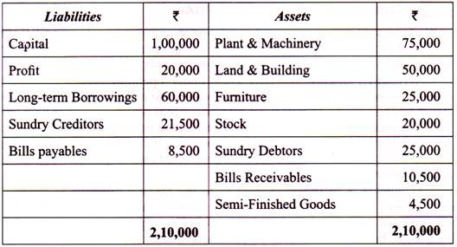
Example:
The following is the Balance Sheet of Jindal Textiles Private Ltd. as at 31st December, 2019:

Slide 21
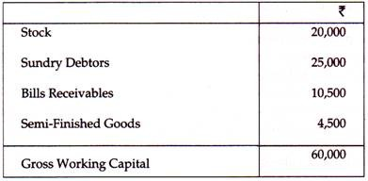
Now, the Gross Working Capital will be:

Slide 22
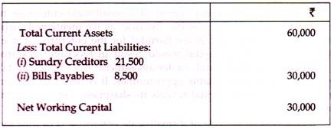
Accordingly, Net Working Capital will be:

Slide 23
The ratio of current assets to current liabilities will be Rs. 60,000: Rs. 30,000, or say 2:1.
On the basic of Time:
Time
Permanent working capital
Regular
Reserve
Temporary working Capital
Seasonal
Special

Slide 24
Permanent Working Capital:
The minimum amount of working capital which even required dur­ing the dullest season of the year is known as Permanent working capital.
(f) Temporary or Variable Working Capital:
It represents the additional current assets required at different times during the operating year to meet additional inventory, extra cash, etc.

Slide 25
It can be said that Permanent working capital represents minimum amount of the current assets required throughout the year for normal production whereas Temporary working capital is the addi­tional capital required at different time of the year to finance the fluctuations in production due to seasonal change. A firm having constant annual production will also have constant Permanent work­ing capital and only Variable working capital changes due to change in production caused by seasonal changes.

Slide 26
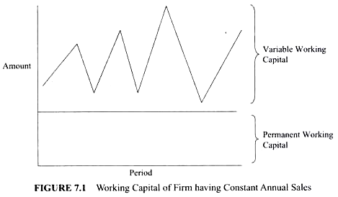

Slide 27
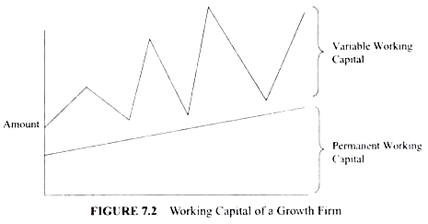
Similarly, a growth firm is the firm having unutilized capacity, however, production and operation continues to grow naturally. As its volume of production rises with the passage of time so also does the quantum of the Permanent working capital.

Slide 28
Components of Working Capital:
Working capital is composed of various current assets and current liabilities, which are as follows:
(A) Current Assets:
These assets are generally realized within a short period of time, i.e. within one year.
Current assets include:
(a) Inventories or Stocks
(i) Raw materials
(ii) Work in progress
(iii) Consumable Stores
(iv) Finished goods

Slide 29
(b) Sundry Debtors
(c) Bills Receivable
(d) Pre-payments
(e) Short-term Investments
(f) Accrued Income and
(g) Cash and Bank Balances
(B) Current Liabilities:
Current liabilities are those which are generally paid in the ordinary course of business within a short period of time, i.e. one year.
Current liabilities include:
(a) Sundry Creditors
(b) Bills Payable
(c) Accrued Expenses
(d) Bank Overdrafts
(e) Bank Loans (short-term)

Slide 30
CASH MANAGEMENT

Slide 32
Cash - What is cash?
Cash is the most liquid asset and is vital for the solvency of a company From an accounting perspective, cash is the most liquid asset a company can possess. A cash balance indicates that a company has cash on hand and can use that cash however it wishes. Cash includes more than just the physical traditional bills and coins. Cash can include any other currencies, as well as undeposited cheques and amounts in a current account.

Slide 33
Cash Management
Definition: Cash Management refers to the collection, handling, control and investment of the organizational cash and cash equivalents, to ensure optimum utilization of the firm’s liquid resources. Money is the lifeline of the business, and therefore it is essential to maintain a sound cash flow position in the organization.

Slide 34
.
Four facts of cash management
cash management
cash planing
Investing surplus cash
optimum cash level
managing the cash flow

Slide 35
Objectives of Cash Management:
Fulfil Working Capital Requirement: The organization needs to maintain ample liquid cash to meet its routine expenses which possible only through effective cash management.
Planning Capital Expenditure: It helps in planning the capital expenditure and determining the ratio of debt and equity to acquire finance for this purpose.
Handling Unorganized Costs: There are times when the company encounters unexpected circumstances like the breakdown of machinery. These are unforeseen expenses to cope up with; cash surplus is a lifesaver in such conditions.

Slide 36
Cash Management Models
Cash management requires a practical approach and a strong base to determine the requirement of cash by the organization to meet its daily expenses. For this purpose, some models were designed to determine the level of money on different parameters.

Slide 37
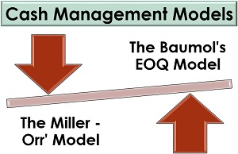
The two most important models are discussed in detail below:

Slide 38
Let us now elaborate on each of these models: According to the transaction theory, money is a dominated asset people hold money unlike other assets, to make purchases. Baumol-Tobin model shows that demand for money depends positively on the income level and negatively on the interest rate. This model is explained in terms of assets. An individual holds portfolio for monetary assets (currency and checking account) and non-monetary assets (stocks and bonds).

Slide 39
The optimum amount of asset he can hold will depend on the cost considerations:
(i) Interest forgone on the cash balance held, and
(ii) Cost of acquiring bonds and converting them into cash, i.e., cost of brokerage

Slide 40
Money has both cost and benefit. Cost is the low rate of return and benefit is that, it makes transactions more convenient.
So people decide how much money to hold by trading off these costs and benefits. Baumol-Tobin was not satisfied with Keynes treatment of demand for money so he developed the model of cash management in 1950 in which he explained the costs and benefits of holding money. People hold money in cash for convenience. When people hold money they incur both benefit and cost. Benefit is the convenience which they get by avoiding making a trip to the bank every time they wish to buy something. But the cost of this convenience is the forgone interest which they would have earned if they had deposited the money in the saving accounts. There is, thus, a trade off between benefits and costs.If one holds large amount of monetary assets, interest forgone will be very high but if one holds less cash, then the interest forgone will be less but the transaction cost of holding bonds, i.e., brokerage fee will be very high. To avoid these extreme situations, people will hold both monetary and non-monetary assets to minimize the cost.

Slide 41
1. Price level is constant
2. Transactor has a given income. Real spending is constant over the year, that is, an individual spends uniformly over the year.
3. Transaction funds can be held either in money or in interest yielding bonds.
4. Individual X makes ‘N’ trips to the bank. Mr. X plans to spend Rs. Y gradually over a year.

Slide 42
Miller-Orr Model Definition
The Miller-Orr model of cash management is developed for businesses with uncertain cash inflows and outflows. This approach allows lower and upper limits of cash balance to be set and determine the return point (target cash balance). This is different from the Baumol-Tobin model, which is based on the assumption that the cash spending rate is constant.

Slide 44
Assumptions
The Miller-Orr model of cash management can be used if the following assumptions are met:
The cash inflows and cash outflows are stochastic. In other words, each day a business may have both different cash payments and different cash receipts.
The daily cash balance is normally distributed, i.e., it occurs randomly.
There is a possibility to invest idle cash in marketable securities.
There is a transaction fee when marketable securities are bought or sold.

Slide 45
Formula
The return point for the cash balance under the Miller-Orr model can be calculated as follows:
Return Point = Lower Limit + 1/3 × Spread
The lower limit is set by management. It depends on the acceptable risk of cash flows gap, creditworthiness of a business, and expected needs in cash. However, the lower limit can be set as zero if a business has sufficient investments in marketable securities or perfect creditworthiness and can raise additional short-term debt at any time.
The equation to compute the spread is as follows:
Where F is the transaction cost, K is the opportunity cost of holding cash, and σ2 is a of a daily cash balance.
To find the upper limit of the cash balance, the following formula should be used:
Upper Limit = Lower Limit + Spread

Slide 46
A is when the actual cash balance drops to the lower limit. A company’s management should replenish it to reach the return point, which can be done by selling investments in marketable securities.
B is when the actual cash balance touches the upper limit. In such cases, it is necessary to buy marketable securities and restore the cash balance down to the return point. The amount to be invested is the difference between the upper limit and return point.

Slide 47

Example
The management of Stilmill Inc. has set a safety cash balance of $50,000. The standard deviation (σ) of the daily cash balance during the last year was $37,500, and the transaction cost was $75. The company also has the opportunity to invest idle cash in marketable securities at an annual interest rate of 8%.
Daily interest rate = 8%∕365 = 0.022%
Return point = $50,000 + 1∕3 × $213,325 = $121,108
Upper limit = $50,000 + $213,325 = $263,325

